Slide 1
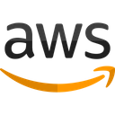

CS 470 Project Two: Conference Presentation Cloud Development
By July Wellman
October 2025
Notes:
Hello, my name is July Wellman. In this presentation, I will walk through my experience migrating a full-stack Angular application into a cloud-native architecture using AWS microservices. My goal is to explain how modern web applications evolve from local development to scalable, serverless cloud environments.

Slide 2
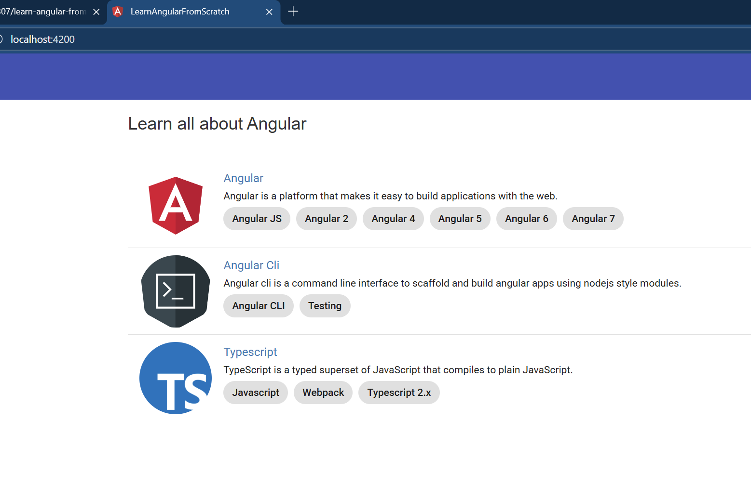
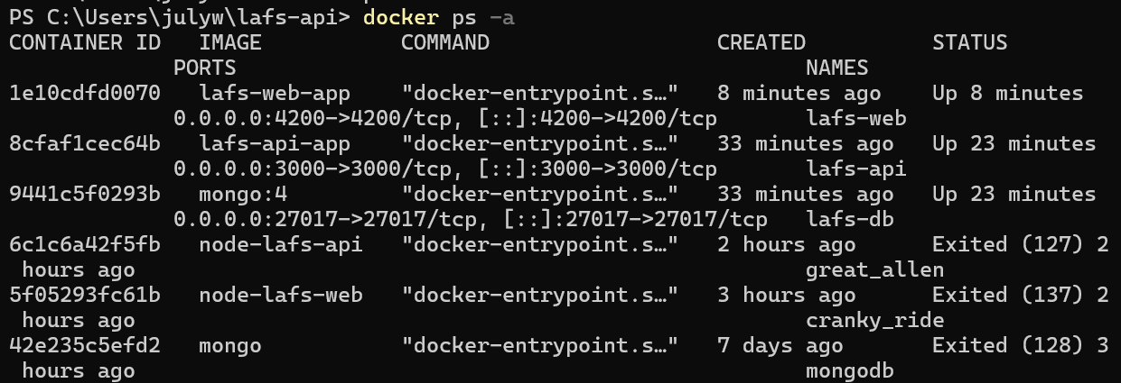
Purpose & Overview
Purpose: To explain the process and challenges of moving a full-stack application to AWS cloud infrastructure.
Overview:
Containerization and orchestration
Serverless development
Cloud scalability principles
Security best practices
Notes:
The purpose of this presentation is to describe the process and challenges of migrating a full-stack web app to AWS. I’ll cover containerization, serverless architecture, scalability principles, and cloud security practices.

Slide 3
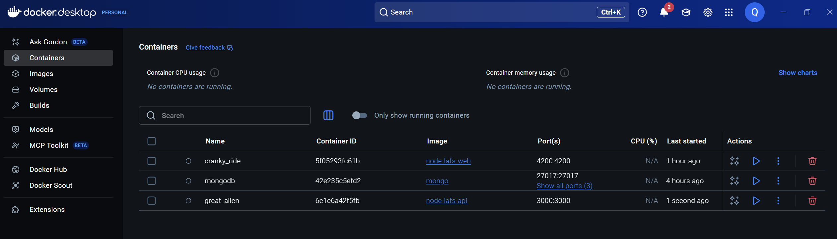
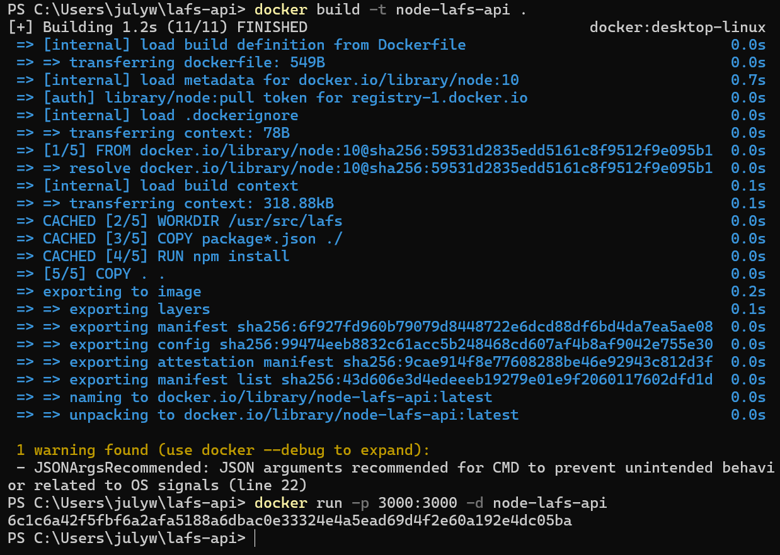
From Local Stack to Containers
Used PowerShell to initialize Angular site and containerized the full stack using Docker.
Frontend, backend, and database was isolated in its own container, ensuring consistent performance across environments.
Notes:
The first step in my migration was containerization. I used PowerShell to initialize the Angular site and wrapped it with Docker containers. Each service: frontend, backend, and database, was isolated to ensure consistent environments for development and deployment.

Slide 4
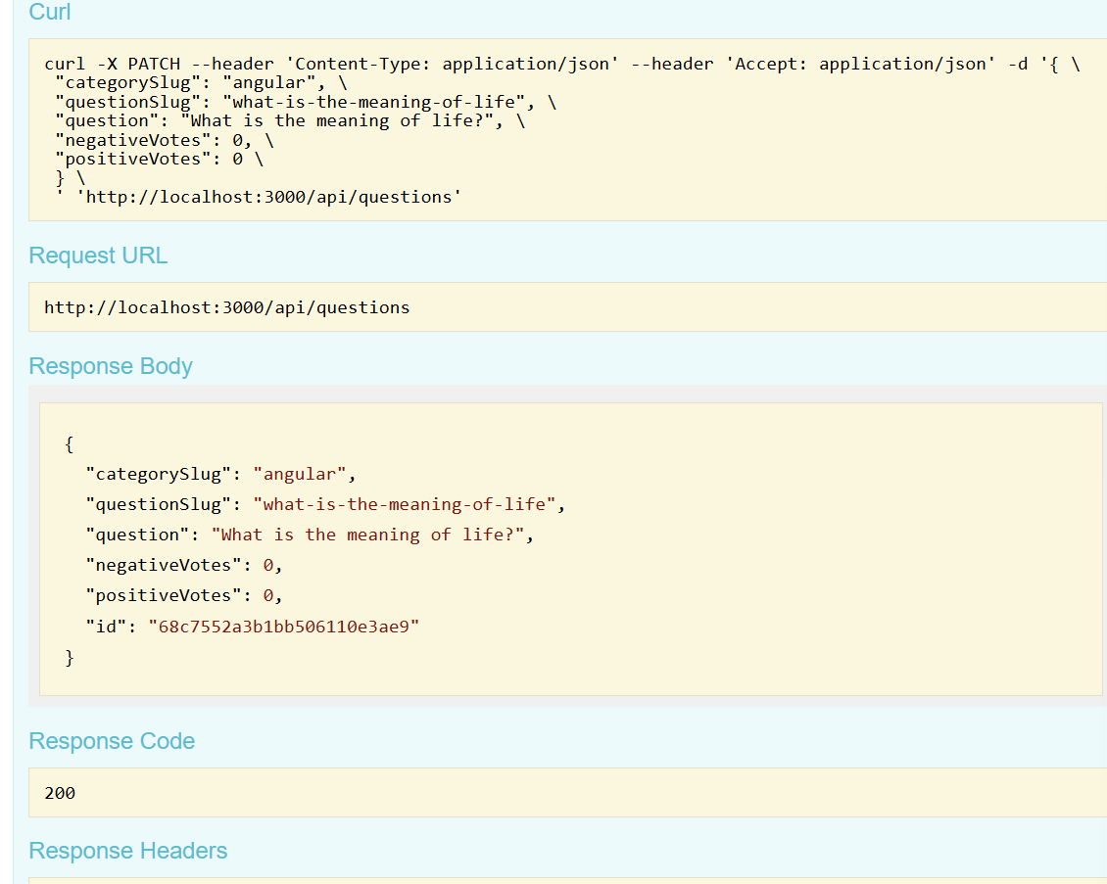
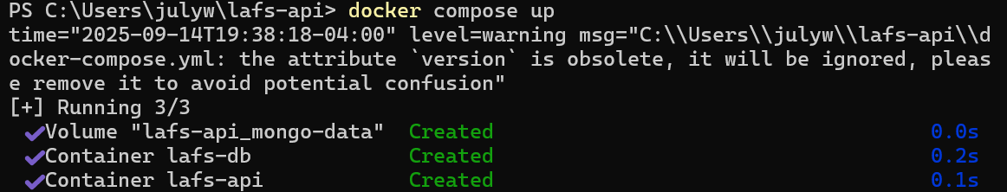
Tools for Containerization
Docker Compose simplified orchestration by defining services, networks, and volumes in one YAML file. This allowed the full stack to be deployed with a single command.
Tools used:
Docker Desktop
Docker Compose
PowerShell
Notes:
I used Docker Desktop, Docker Compose, and PowerShell to manage automation. Docker Compose simplified orchestration by defining services and networks in a single YAML file. The benefit to Docker is with one command, I could deploy or stop the entire stack, improving workflow efficiency.

Slide 5
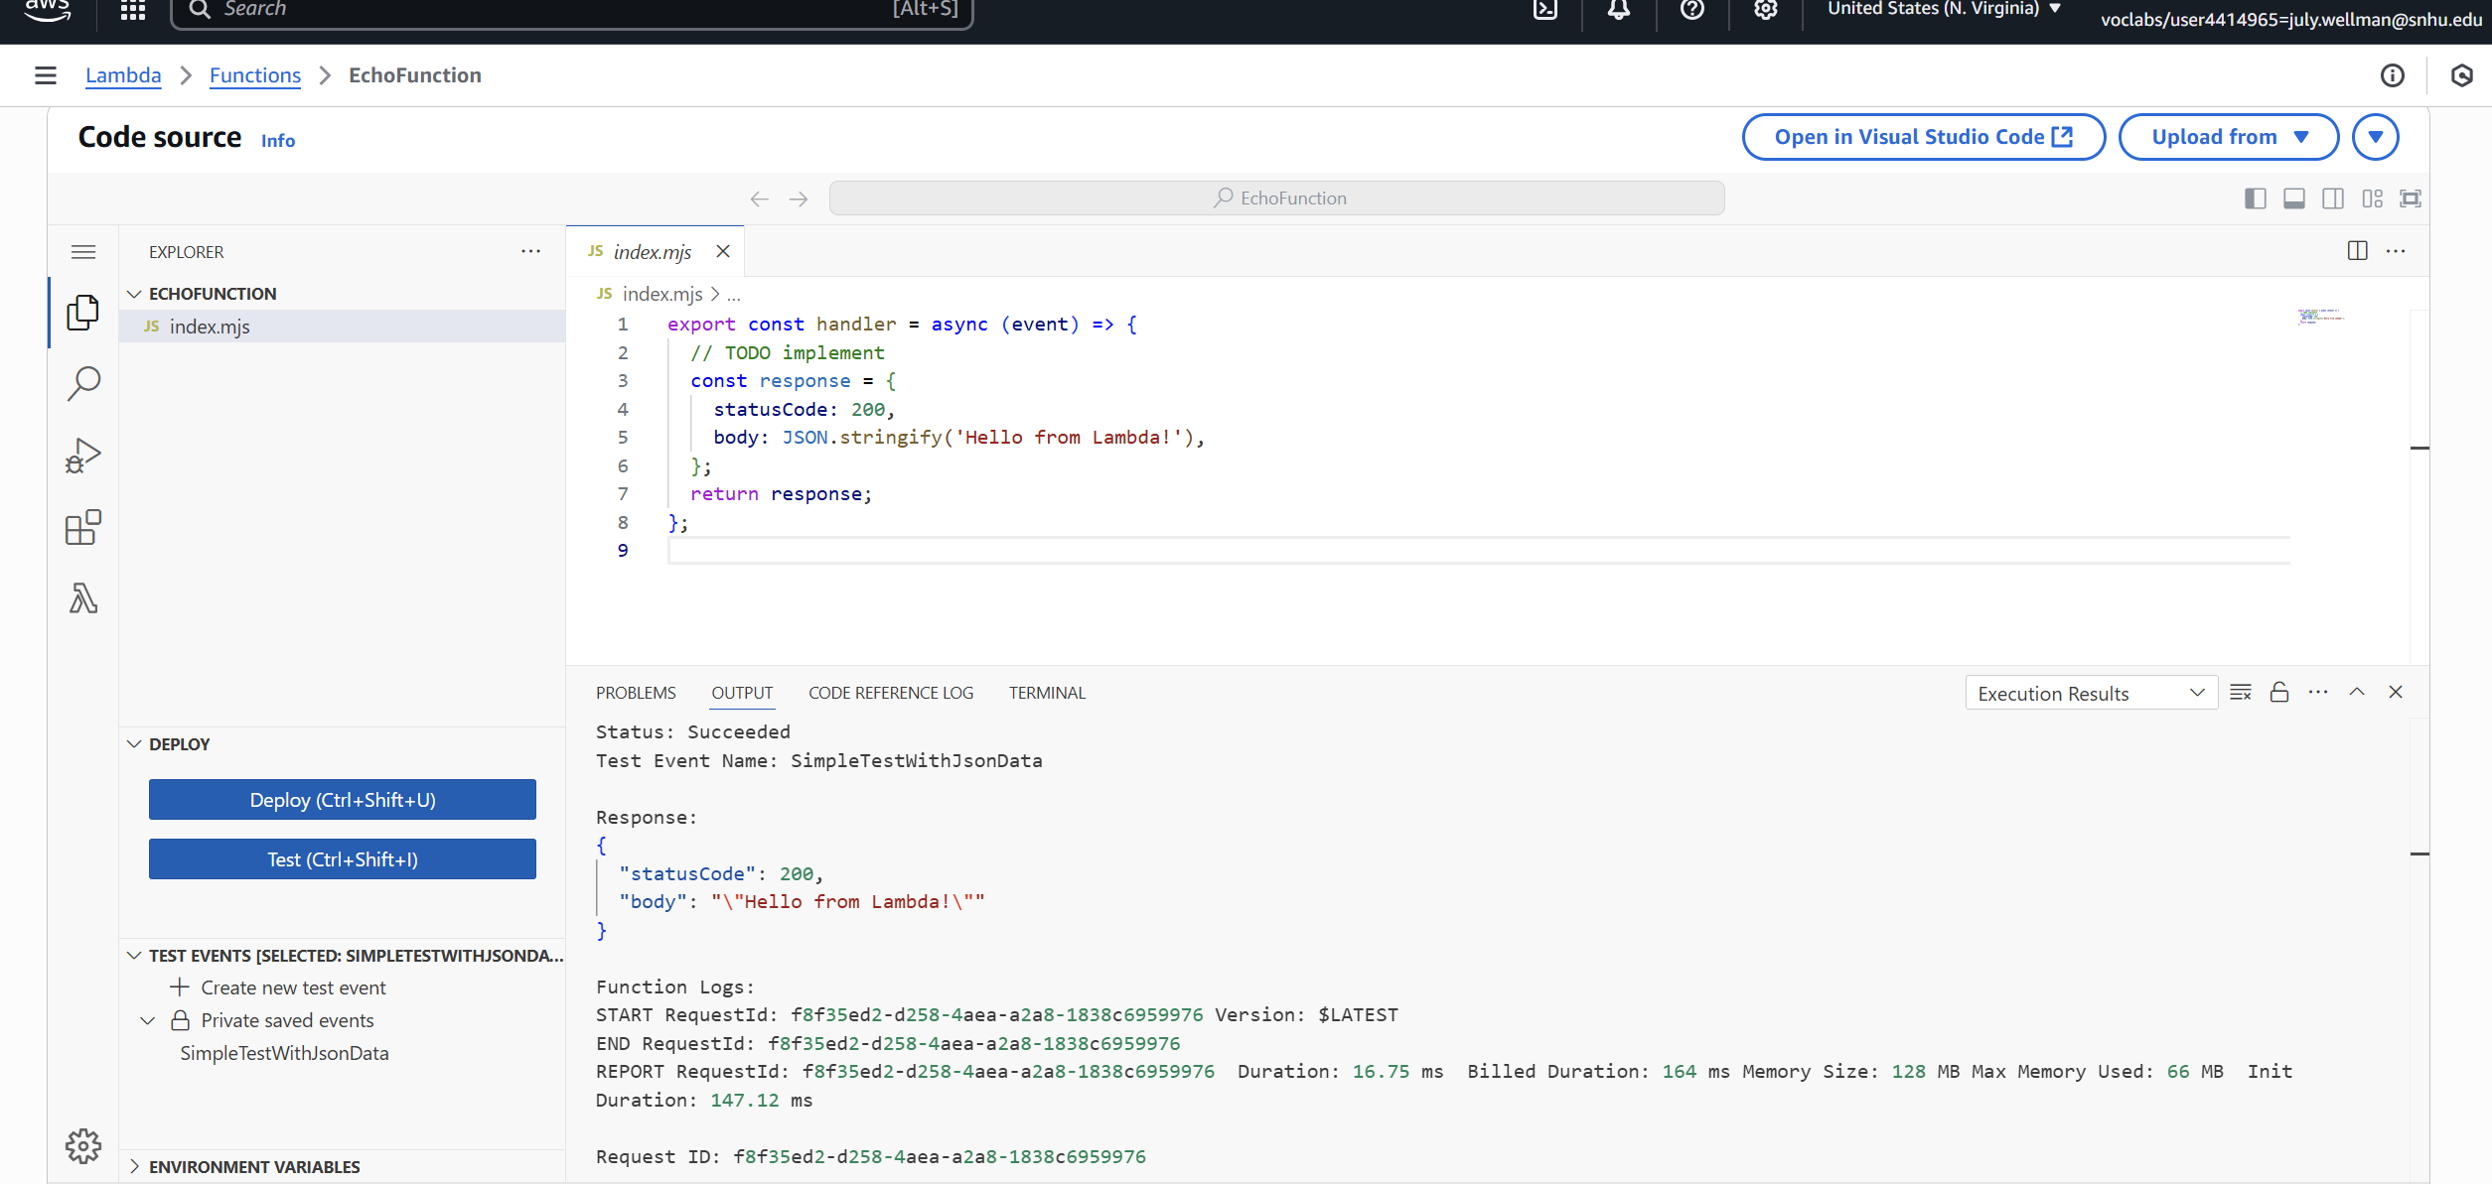
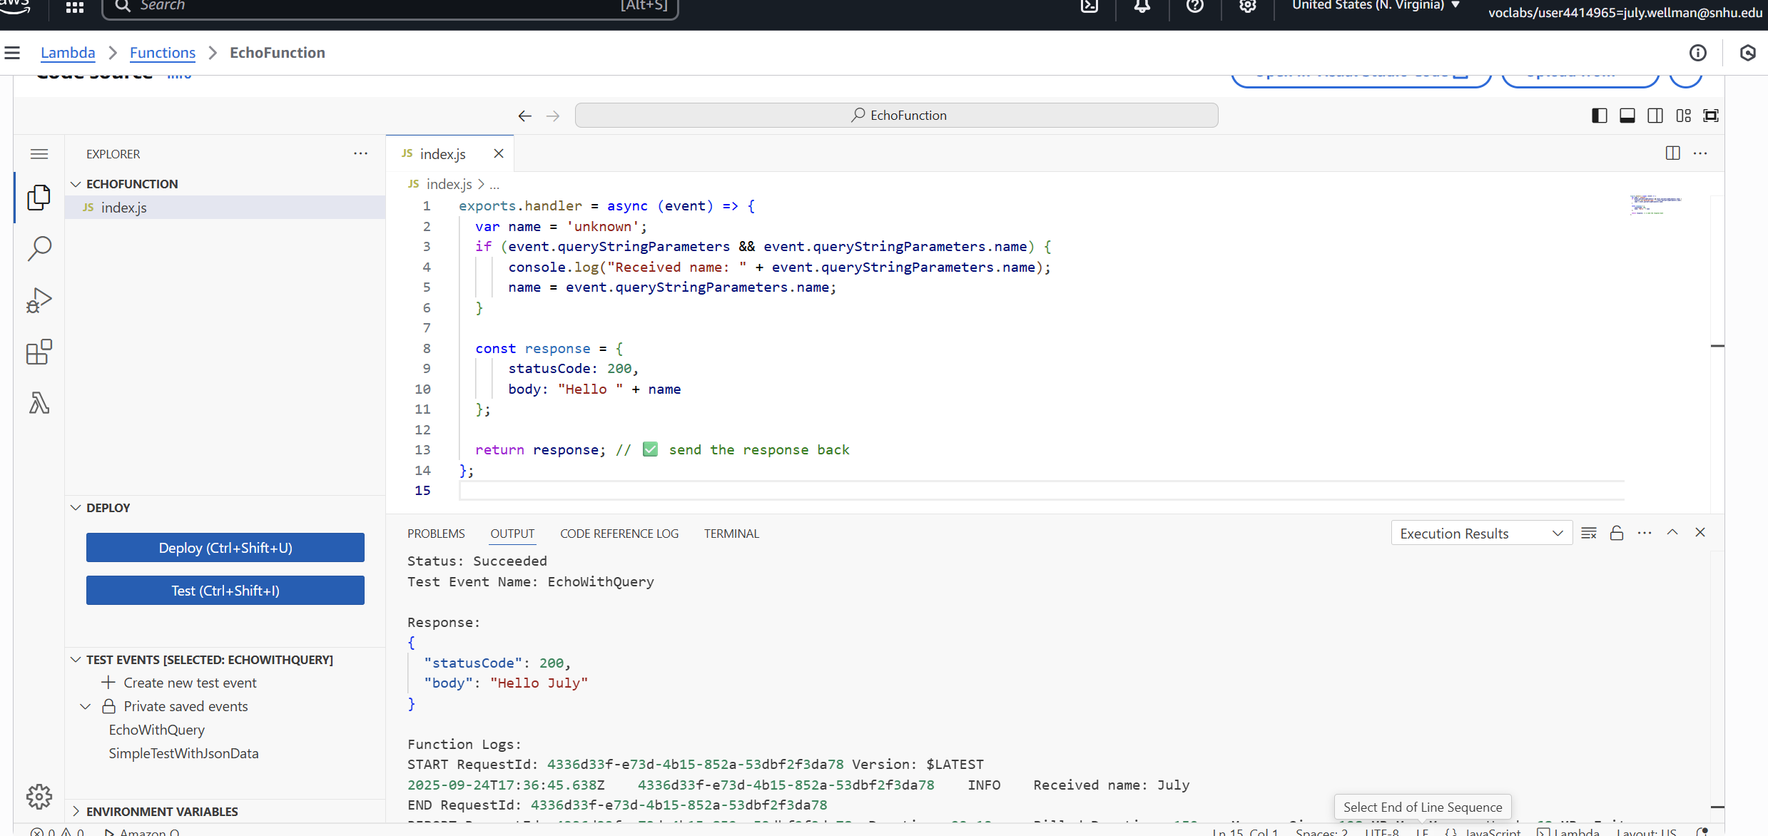
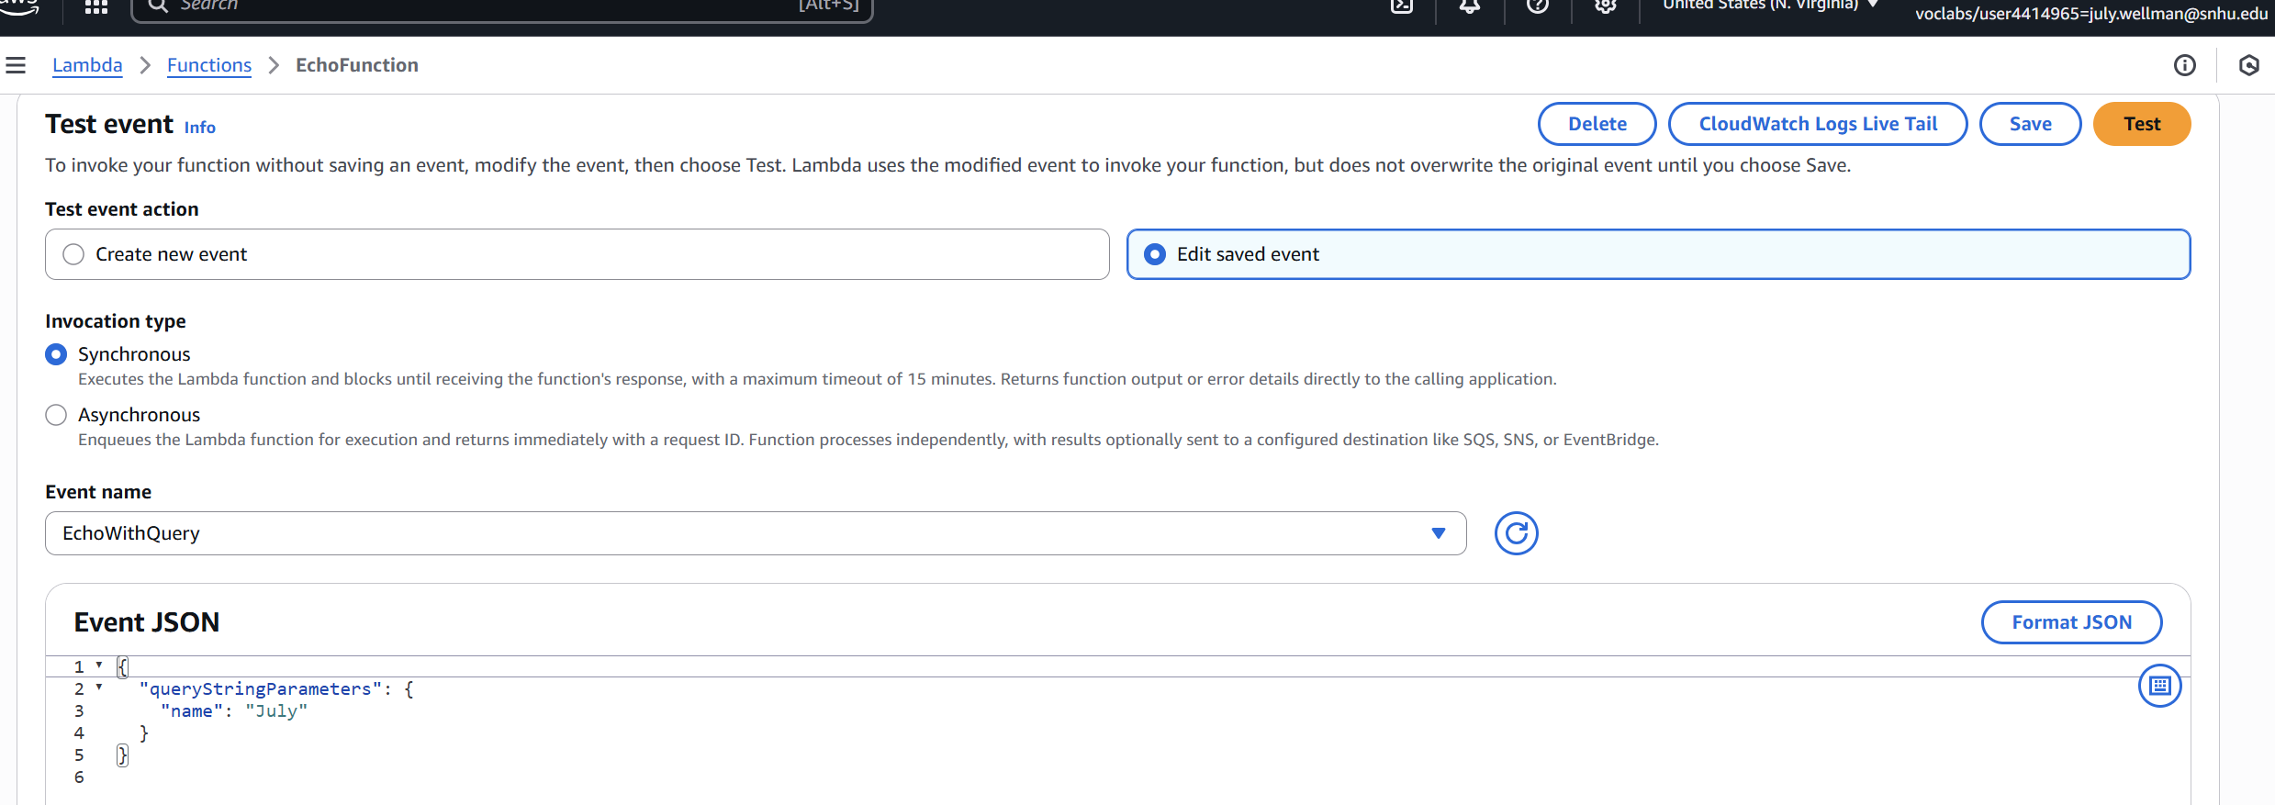
Understanding Serverless Architecture
Serverless computing eliminates the need for managing servers.
Using AWS Lambda and API Gateway:
Functions scale automatically
You only pay for execution time
Simplifies backend management
Notes:
Next, I transitioned parts of the backend to AWS Lambda. Serverless computing removes the need for manual server management. Lambda functions automatically scale, run on demand, and you only pay for the actual execution time.

Slide 6
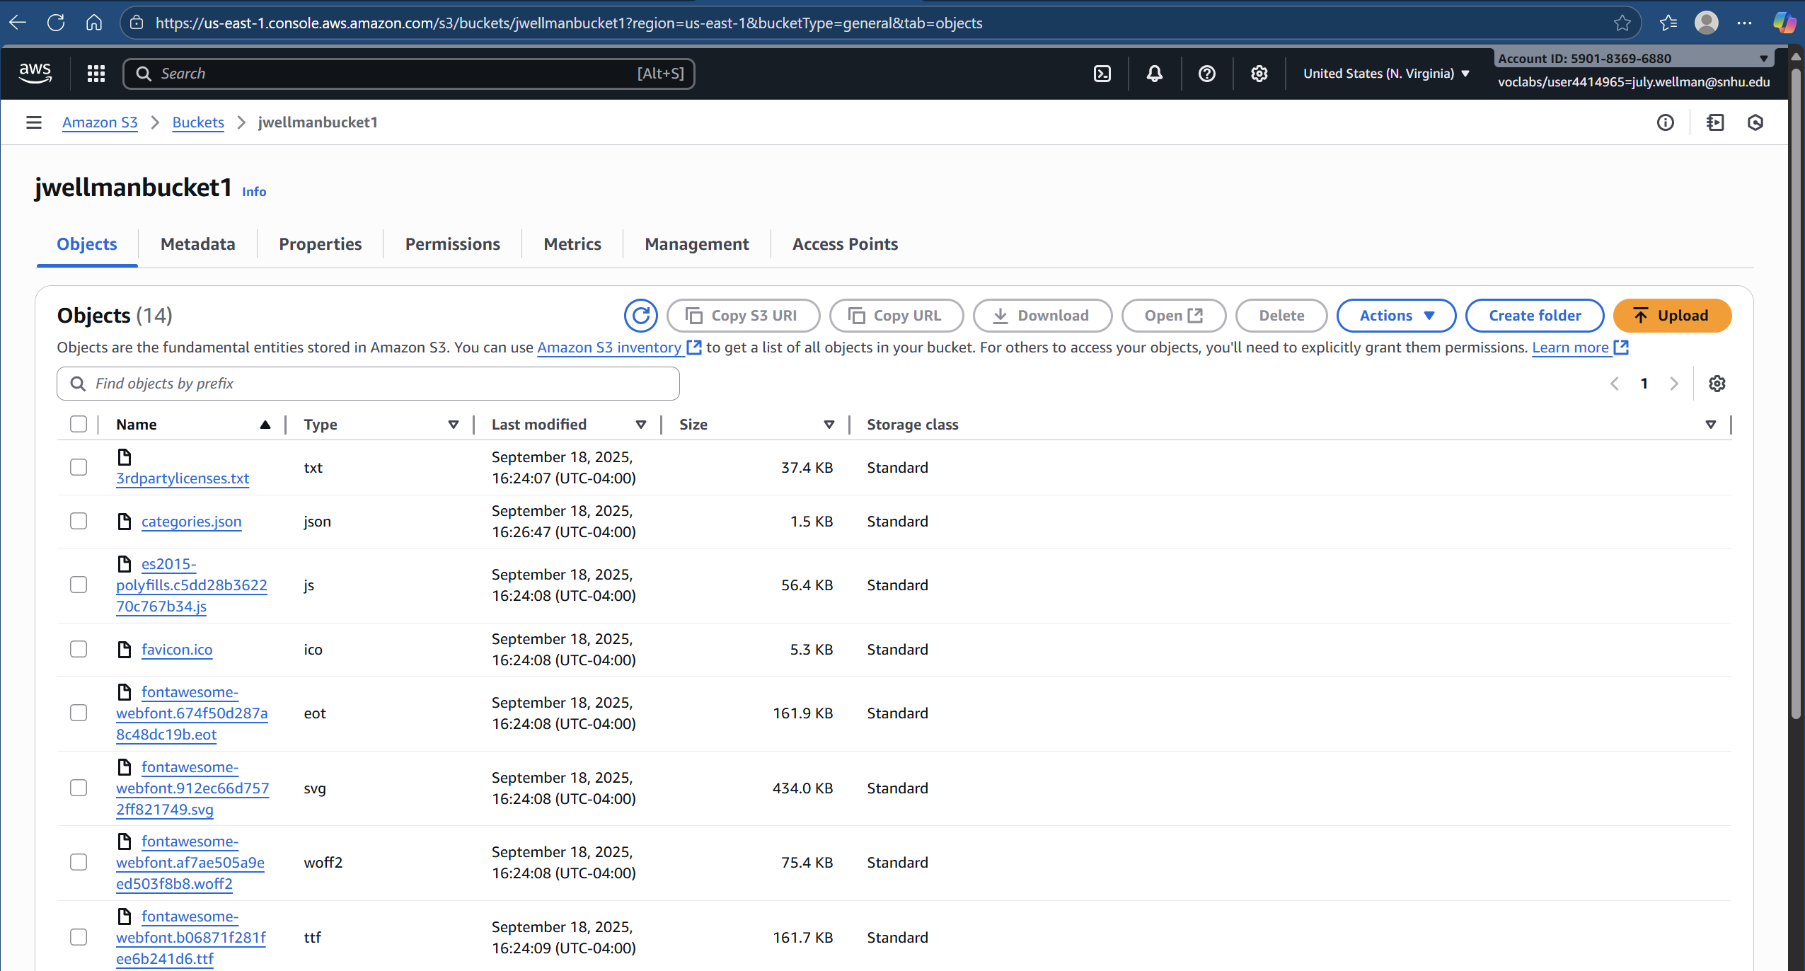
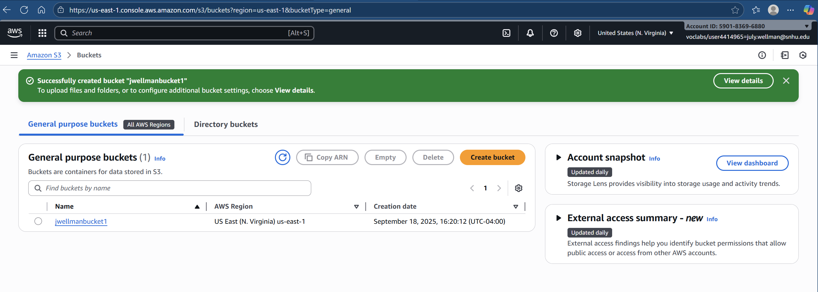
S3 Storage vs Local Storage
Amazon S3 replaces local storage with a durable, globally available service.
Advantages:
High durability
Versioning and backups
Static website hosting for Angular frontend
Notes:
I replaced local hosting with Amazon S3. It offers high durability, redundancy, and scalability. Hosting the Angular frontend in S3 eliminated the need for a dedicated web server and made it globally accessible.

Slide 7
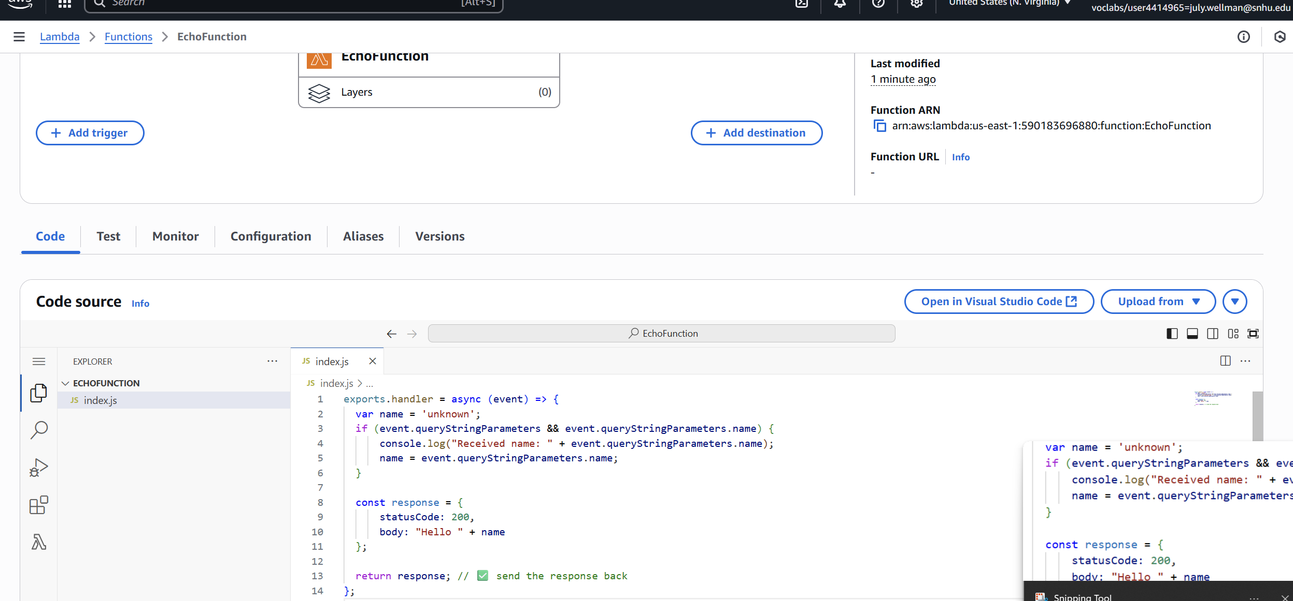
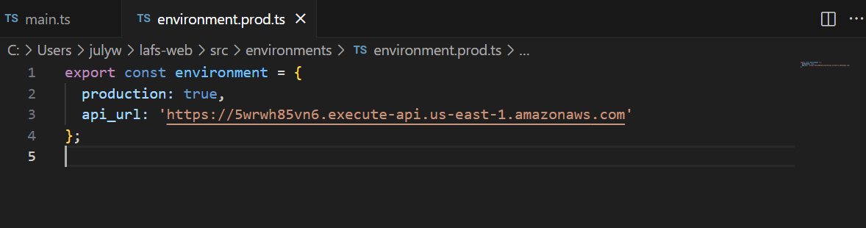
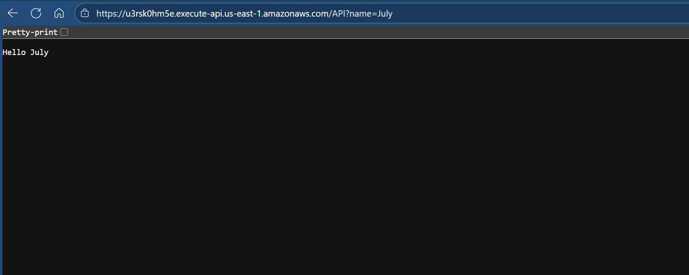
Integrating Lambda with API Gateway
Lambda functions handle backend logic using Node.js.
Integration Steps:
1. Create Lambda function for each route
2. Connect API Gateway endpoints
3. Configure IAM permissions
4. Deploy and test API integration
Notes:
I used AWS Lambda for backend logic and API Gateway to handle requests. Each Lambda function represented a specific route, such as retrieving or updating trip data. The integration involved setting permissions, linking endpoints, and deploying the API.

Slide 8
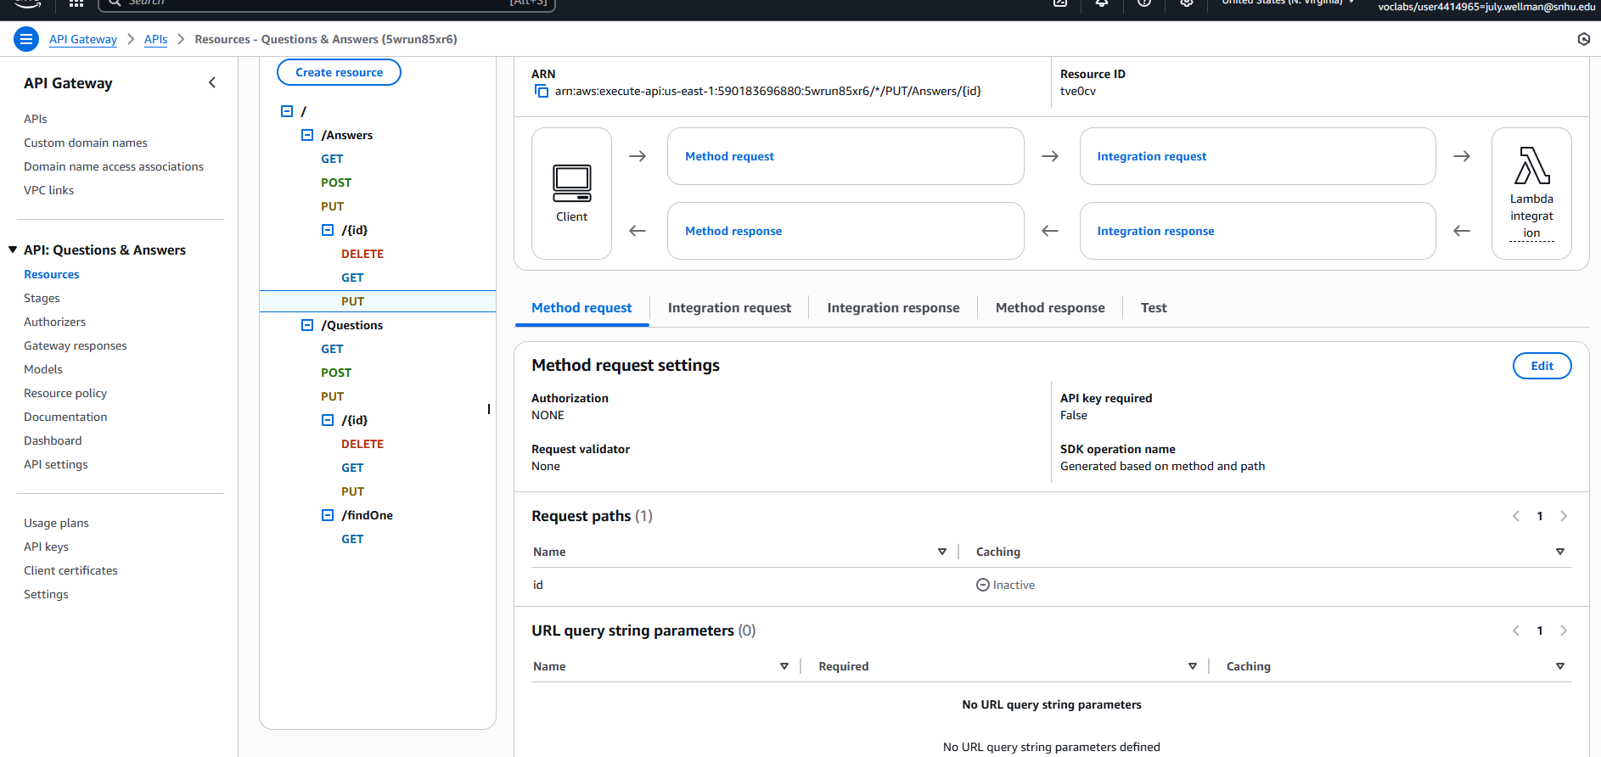
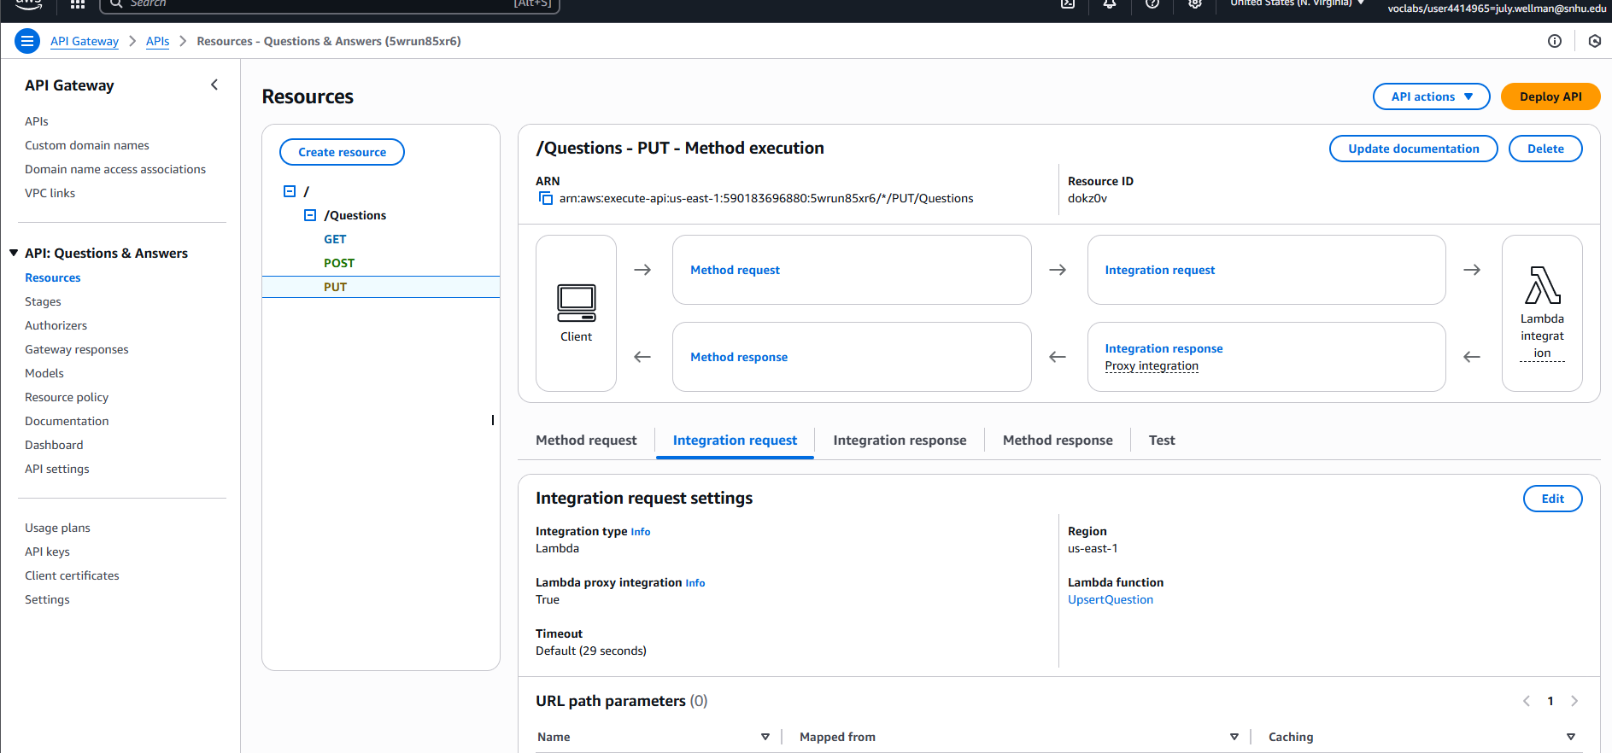
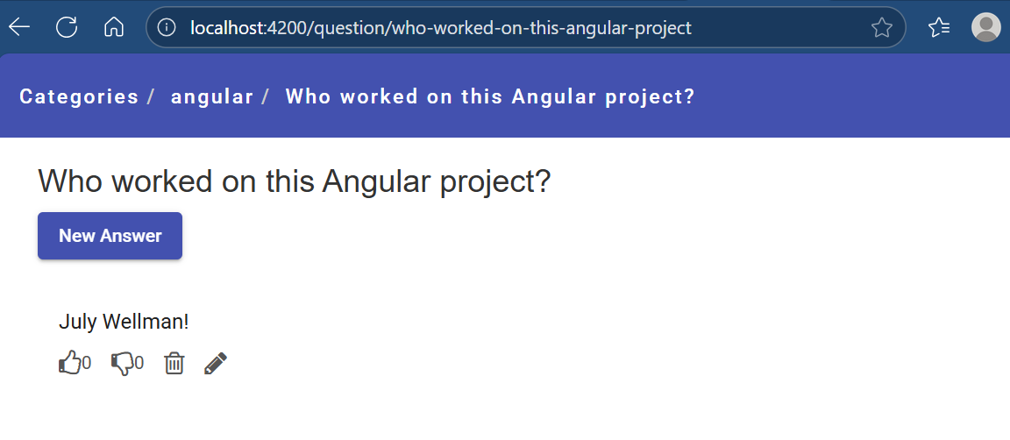
Data Model Differences: MongoDB vs DynamoDB
MongoDB uses flexible JSON documents, while DynamoDB uses key-value and document-based models.
In DynamoDB:
Data is structured by partition and sort keys
Queries use the AWS SDK
No schema migrations required
Notes:
Migrating data models required shifting from MongoDB’s flexible schema to DynamoDB’s key-value and document-based design. I used partition and sort keys to define efficient queries through the AWS SDK.

Slide 9
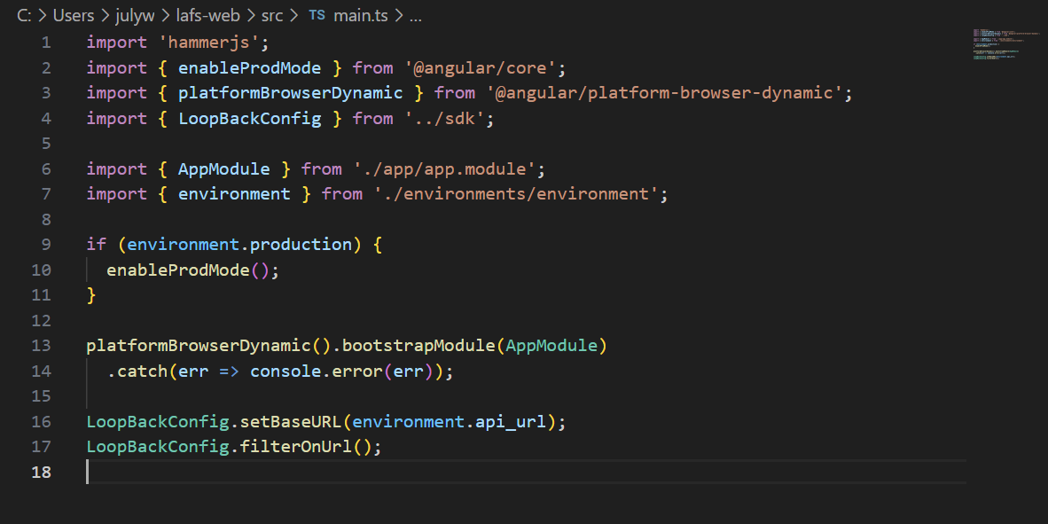
Scalability and Elasticity
Elasticity allows AWS services to automatically scale up or down with user demand.
The pay-for-use model ensures cost efficiency—billing is based only on actual compute or storage usage.
Notes:
AWS provides elasticity, allowing resources to scale automatically with demand. The pay-for-use model ensures you only pay for what you consume—ideal for dynamic workloads and cost management.

Slide 10
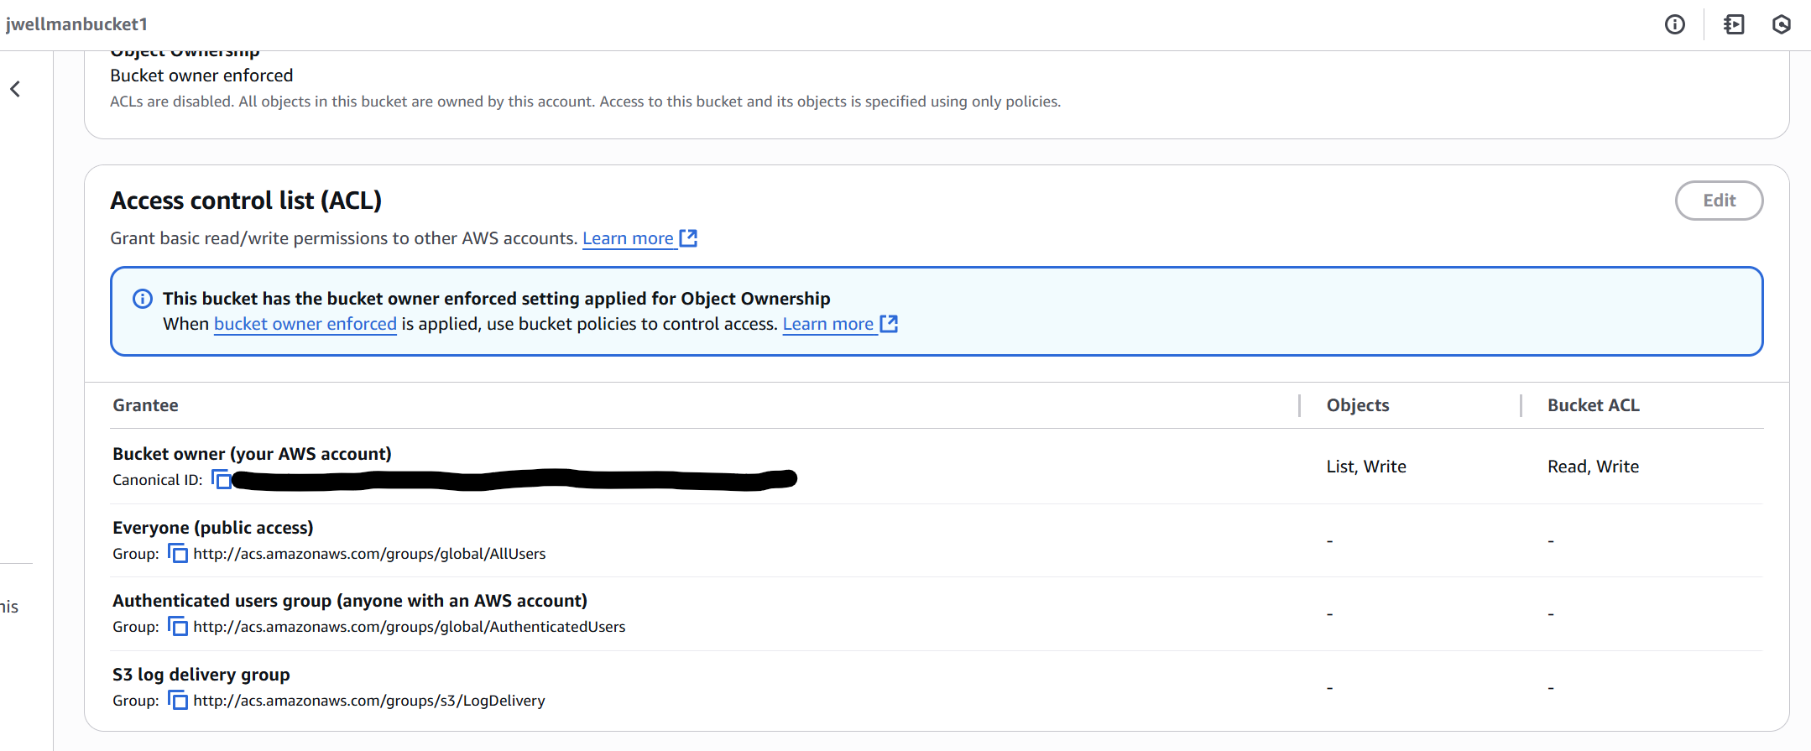
IAM Roles and Policies
AWS IAM controls access using roles and policies.
Best practices applied:
Principle of Least Privilege
Custom Lambda-to-DynamoDB and Lambda-to-S3 roles
Resource policies to restrict access
Notes:
Security was handled using IAM roles and policies. I followed the Principle of Least Privilege, creating roles that allowed Lambda to access only the necessary S3 buckets and DynamoDB tables.

Slide 11
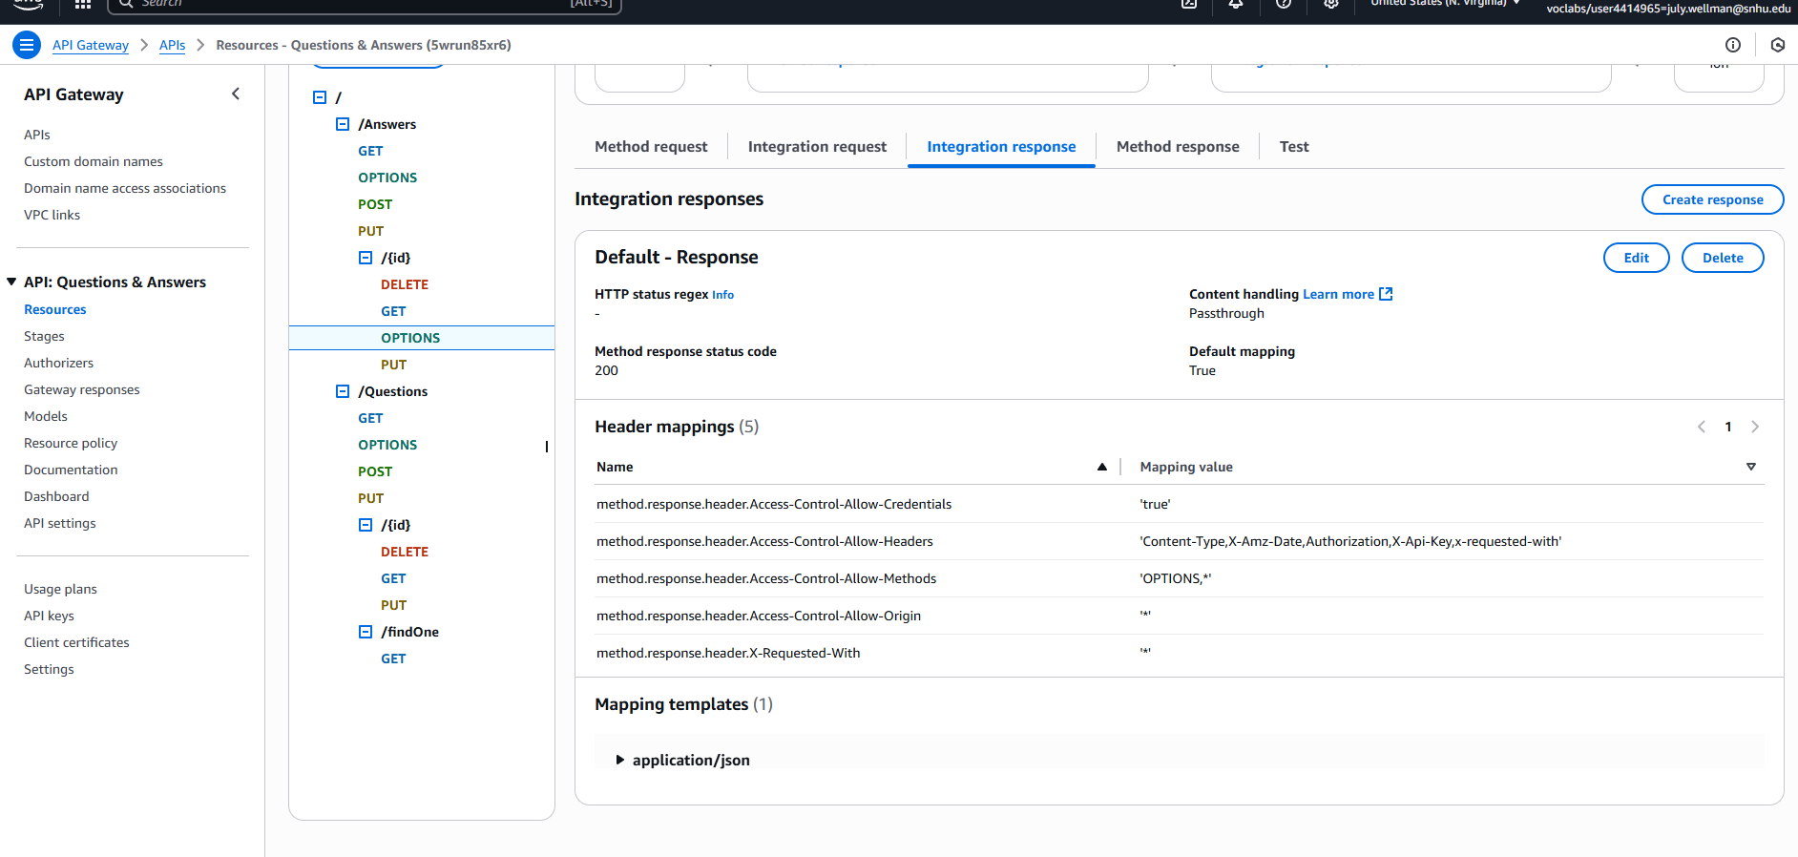
Securing Cloud Connections
Security layers implemented:
HTTPS for all web communication
IAM trust relationships for inter-service connections
Environment variables for credentials instead of hard-coded secrets
Notes:
Connections between services were secured using HTTPS, IAM trust policies, and environment variables. This ensured that sensitive credentials were never hard-coded or exposed in the codebase.

Slide 12
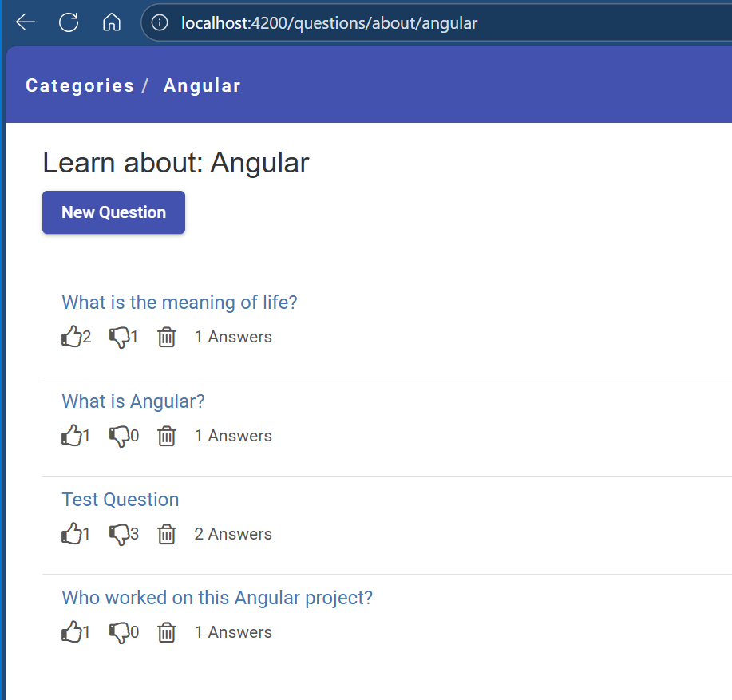
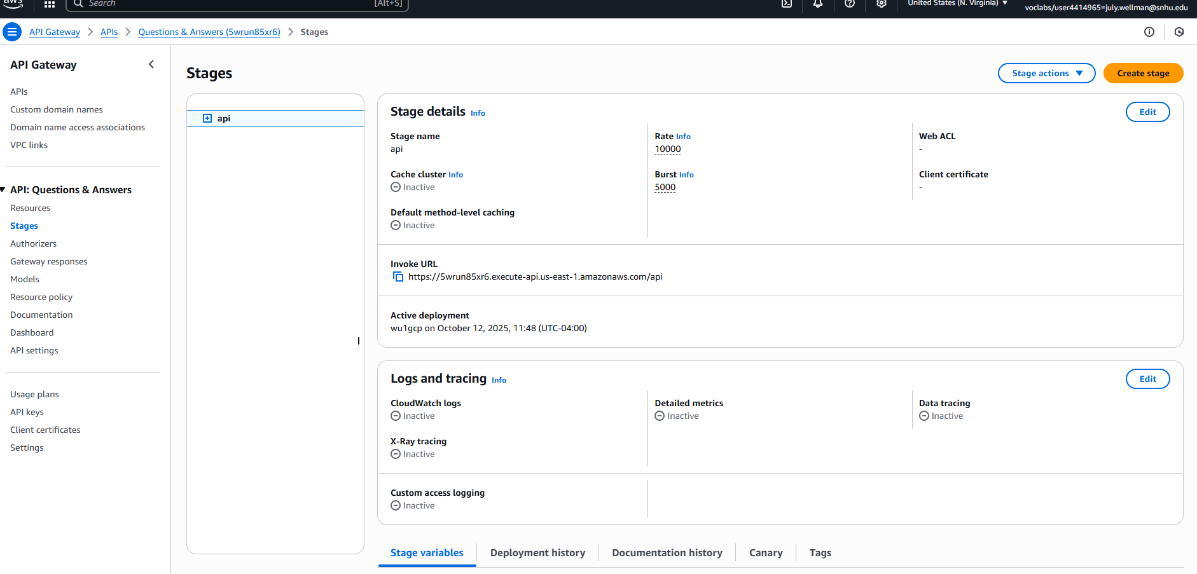
Key Takeaways
This migration provided hands-on experience in modern cloud-native development principles.
1. Docker containerization streamlined deployment.
2. AWS Lambda and API Gateway enabled serverless scalability.
3. IAM roles and encryption enhanced security.
Notes:
To summarize: Docker provided environment consistency, AWS Lambda enabled serverless scalability, and IAM policies ensured secure access control. This migration strengthened my understanding of cloud-native development and deployment. My biggest obstacle was ensuring I was on the correct version when initially putting the project together. Overall, I found this project to be beneficial in growing my strengths in creating single page web application. Thank you for watching.

